Slide 1

FUNDRAISING CAMPAIGN ANALYSIS
ARUNKKUMAR KARTHIKEYAN
ASHVAL VAIDYA
ZHIBO ZHANG
GROUP 04

Slide 2
OVERVIEW
Data
Preparation
Overview
Background
Objectives
Application
Insights

Slide 3
BACKGROUND

Slide 4

COMPANY AND OBJECTIVE
Re-activation campaign by sending letters to those donors that have been inactive for a long time.
Who are these prospects?:
Past-donors that did not participate in the previous campaign AND those that could donate more than 30 EUR.
Randomly selecting donors yields response rate of 1.8%.
Increase in Response Rate by trageting donors predicted by the model.
Communication Agency based in Brussels,Belgium
Fundraising for 22 humanitarian organizations

Slide 5
OUR STARTING POINT
Campaign 6169 Campaign 7244
Δ% vs LY:
-26%
34,874
Prospects
25,645
Prospects
Donors
957
Donors
217
-77%
30,340 EUR
Costs
14,105 EUR
Costs
-54%
Revenue
98,654 EUR
Revenue
18,616 EUR
-81%

Slide 6

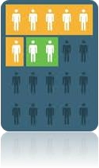


WHAT ARE OUR MAIN TOOLS?
Campaign Historical Information
Train -> Campaign 6169
Test -> Campaign 7244
Donor ID, zipcode, province, Region, gender, language, DOB
Campaign ID, Donor ID, Amount, Date
Donor ID

Slide 7
DATA PREPARATION

Slide 8




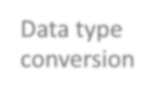















CLEANING PROCESS
Data type
Dataset
Training and test sets
conversion
merge
Data formatting
Missing values
Creating dummy variables
Creation of
new variables

Slide 9

DATA TIMELINE (CONSIDERED PAST 5 YEARS DATA)
TRAIN DATASET
TEST DATASET
Data type
Dataset
Training and test sets
conversion
merge
NEW CAMPAIGN
Aug 4, 2013
May 18, 2014
Jan 1, 2015
Aug 4, 2018
May 18, 2019
May 4 , 2020
Creation of
Sept 4,2018
Target Variable (Train)
June 18,2019
Target Variable (Test)
new variables

Slide 10

WITHOUT AND WITH FEATURE SELECTION METHODS
We have selected all numeric variables (43 variables) as features and initiated the models
Using Feature Selection Methods
How did we select out features?:
Using Pearson Correlation Method (15 variables)
Using SelectKBest (10 variables)

Slide 11

FEATURE SELECTION – PAST-BEHAVIOR MATTERS
However, after some feature selection we found out that below variables are the most important ones:
Gender
Max Gift
Min Gift
Sum_3 (Sum of gifts in March month)
Sum_11 (Sum of gifts in November month)
No_campaigns (Number of Campaigns)
Tot_Amt (Total Amount)
Avg_Amt (Average Amt)
Min Amt
Max Amt
Recency
Length of Relationship
Age
Age_Group

Slide 12
MODEL BUILDING AND VALIDATION

Slide 13

WHAT MODELS DID WE RUN?
We have used six different models without and with feature selection methods
We have used Hyper parameter Tuning for improving Logisitic regression results.
Logistic Regression
Decision Tree
Random Forests
Gaussian
Naive Bayes
Neural Network
KNN
0.64
0.51
0.63
0.57
0.6
0.5

Slide 14
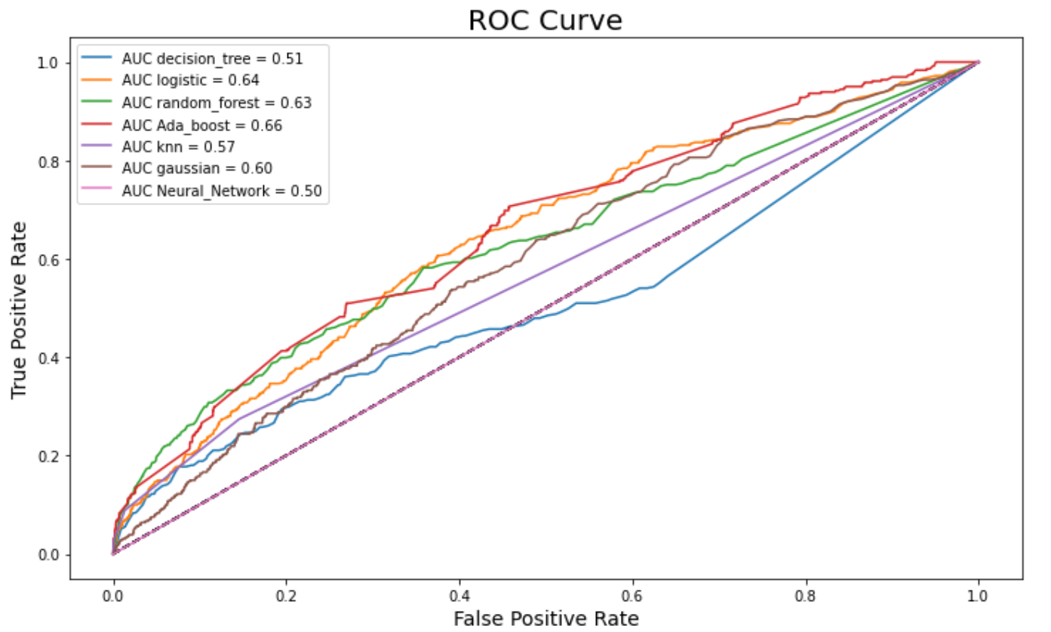
ROC CURVES
Logistic Regression method gives us the highest AUC Score and best true positive rate

Slide 15
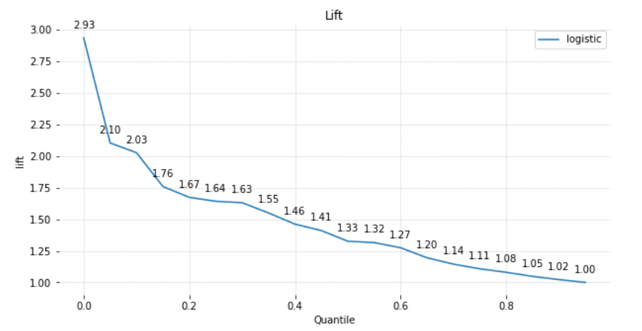
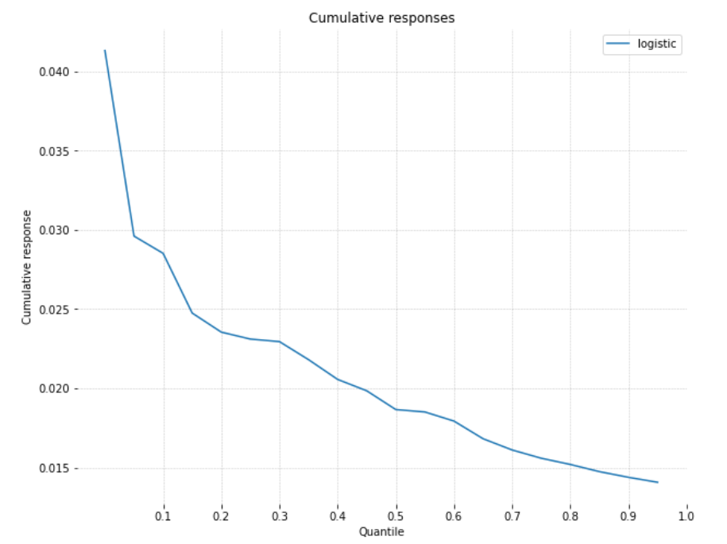
CUMULATIVE RESPONSES / GAINS CURVE
If we contact 40% of population then our model would contact 1.46 times more donors who may donate compared to random selection

Slide 16
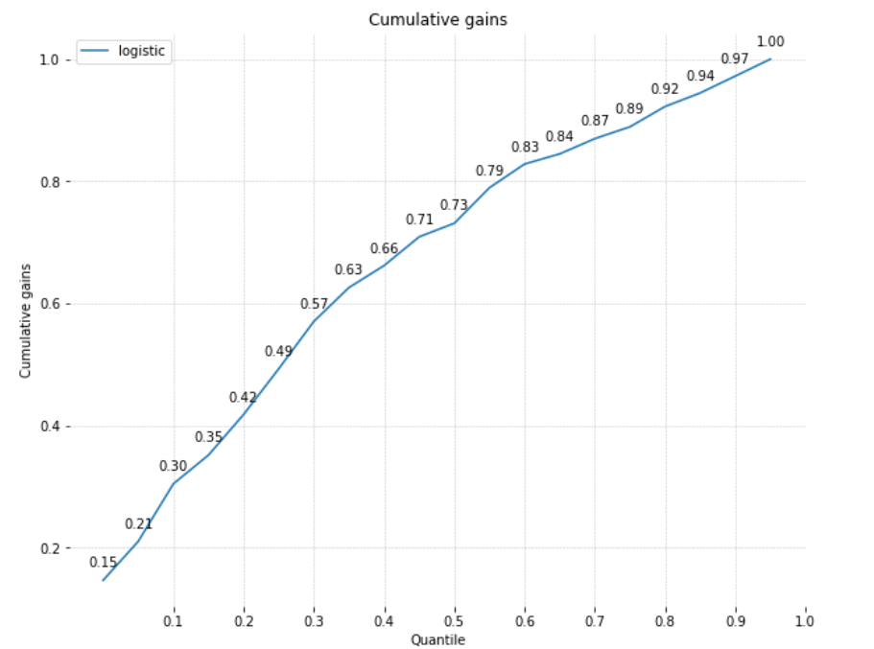
CUMULATIVE RESPONSES / GAINS CURVE
If we contact 40% of population then 66% of all donors would be reached

Slide 17
INSIGHTS

Slide 18

POPULATION SIZE:26,522
GAIN PER DONOR:
€ 67 (Based on Average Donation of previous campaigns)
COST PER PERSON:€ 0.80
CUMULATIVE RESPONSE: 2.1%
POPULATION SELECTED:40%
MAILS:10,609
DONORS:223 (10,609 * 2.1%)
COST:
€ 0.80 * 10,609 = € 8,487
REVENUES:
223 * € 67 = € 14,927
PROFITS : € 6,440
(14,927-8,487)
The campaign can be profitable by selecting the 40% of the donors.

Slide 19
HOW THINGS WOULD BE DIFFERENT WITH OUR MODEL?
Model 7662 Random Selection 7662
Δ% vs LY:
26,522
Prospects
26,522
Prospects
Donors
223
Donors
191
-17.3%
8,487 EUR
Costs
8,487 EUR
Costs
Revenue
14,927 EUR
Revenue
12,794 EUR
-14.2%

Slide 20

THANK YOU

